Slide 1
Analysis of Employee Attrition Data
Using Random Forest and Neural Network

Slide 2
Objective of Analysis:
Understand the data
Explore the data using Rattle
Create a hypothesis using Rattle
Validate the hypothesis through R and Rattle using
Random Forest Model
Neural Network Model
Recommendation and conclusion based on analysis

Slide 3
Data Summary
Attrition data has details on 2940 employees
Data is spread across 35 variables such as:
Age
Department
Gender
Marital Status
Income
Job level
Job Satisfaction
Over Time
Years since last promotion

Slide 4
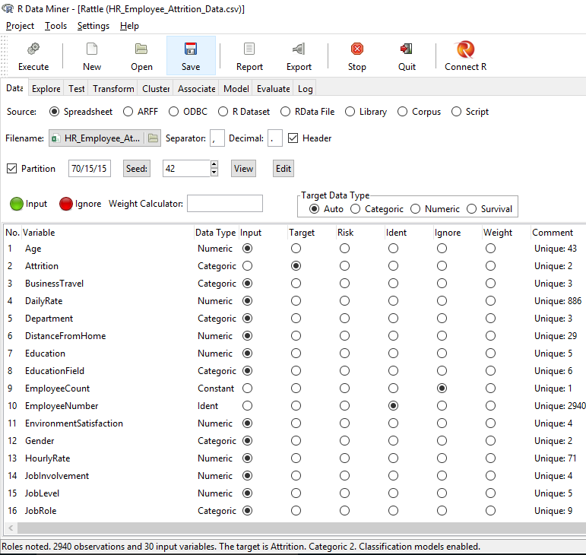
Exploratory Data Analysis using Rattle
Read the attrition data file into Rattle
Get the summary of variables, data type, no of rows

Slide 5
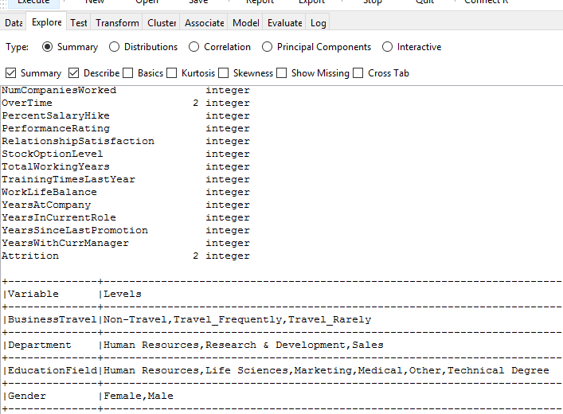
Exploratory Data Analysis - Continued
Summary & description of variables/ levels

Slide 6
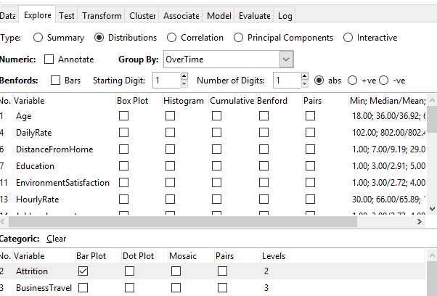
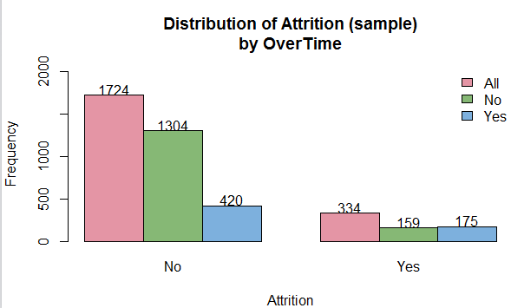
Exploratory Data Analysis - Continued
Distribution of attrition against overtime using Bar Plot
More employees are leaving when overtime is done

Slide 7
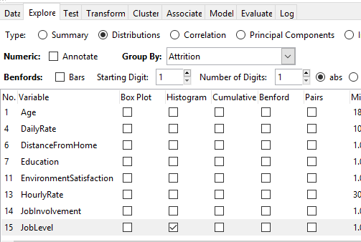
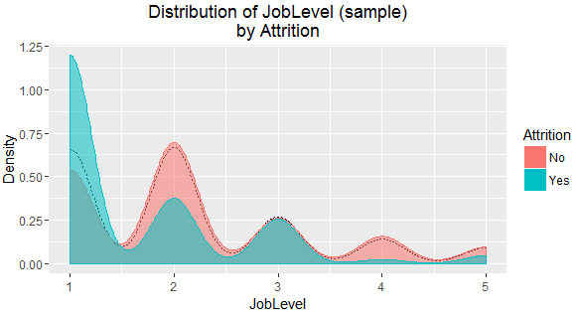
Exploratory Data Analysis - Continued
Attrition by Job level
More attrition is observed at lower job levels

Slide 8
Hypothesis - Null
Null Hypothesis (H0): Following set of fields do not have any impact on Attrition:
Age
Business Travel
Department
Distance from Home
Gender
Job Level
Job Satisfaction
Marital Status
Monthly Income
Over Time
Work Life Balance
Years since Last Promotion

Slide 9
Hypothesis - Alternate
Alternate Hypothesis (Ha): Following set of fields does have impact on Attrition:
Age
Business Travel
Department
Distance from Home
Gender
Job Level
Job Satisfaction
Marital Status
Monthly Income
Over Time
Work Life Balance
Years since Last Promotion

Slide 10
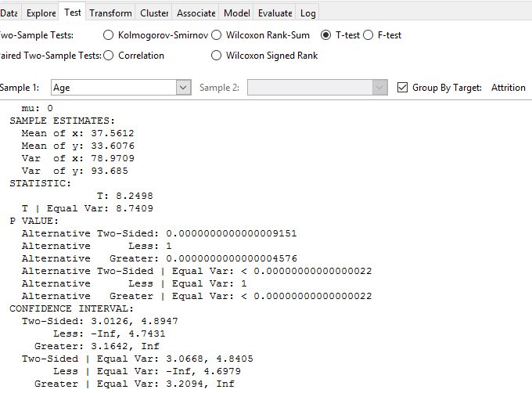
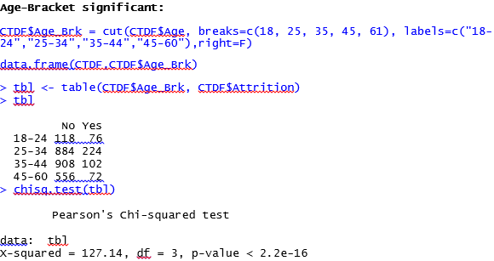
Hypothesis Validation
Hypothesis Testing – Attrition & Age attributes
Age is found to be significant and does impact attrition
Using Rattle
Using R

Slide 11
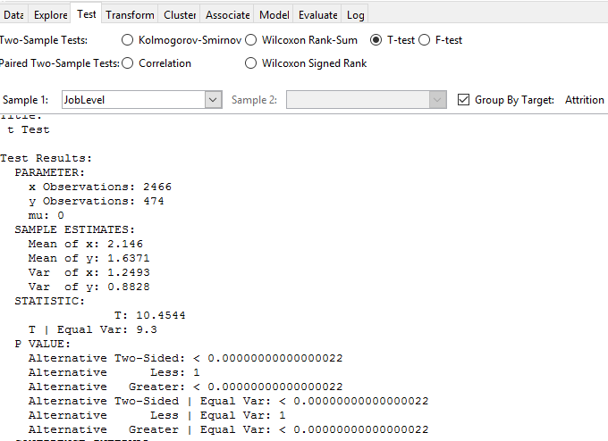
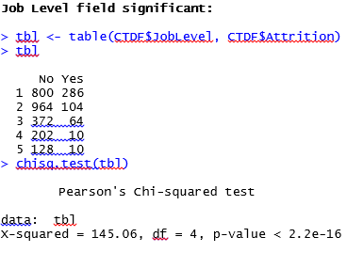
Hypothesis Validation continued
Hypothesis Testing – Attrition & Job Level
Job Level is found to be significant and does impact attrition
Using Rattle
Using R

Slide 12
Random Forest Model using R
Optimized model built after tuning
Accuracy = 90.5%
(Correctly classified both Attrition Yes & No values)
OOB error rate: 9.51%
Attrition ~ .
RF <- randomForest(as.factor(Attrition) ~ ., data = RFHR.dev,
ntree=80, mtry = 10, nodesize = 10,
importance=TRUE)
> print(RF)
Call:
randomForest(formula = as.factor(Attrition) ~ ., data = RFHR.dev, ntree = 80, mtry = 10, nodesize = 10, importance = TRUE)
Type of random forest: classification
Number of trees: 80
No. of variables tried at each split: 10
OOB estimate of error rate: 9.51%
Confusion matrix:
No Yes class.error
No 1693 22 0.01282798834
Yes 172 153 0.52923076923
Model Performance Measures (Dev)
Accuracy = 98.3% (Mis-class = 1.7%)
(Correctly classified both Attrition Yes & No values)
Precision = 89.5%
(Correctly classified Attrition Yes value)
AUC = 0.99
Model Performance Measures (Holdout)
Accuracy = 96.7% (Mis-class = 3.3%)
(Correctly classified both Attrition Yes & No values)
Precision = 79.9%
(Correctly classified Attrition Yes value)
AUC = 0.99
> with(RFHR.dev, table(Attrition, predict.class))
predict.class
Attrition No Yes
No 1715 0
Yes 34 291
> auc
[1] 0.9982886353
> KS
[1] 0.9679353703
> gini
[1] 0.6804073264
> with(RFHR.holdout, table(Attrition, predict.class))
predict.class
Attrition No Yes
No 751 0
Yes 30 119
> auc
[1] 0.9982886
> KS
[1] 0.9679353703
> gini
[1] 0.4301605781

Slide 13
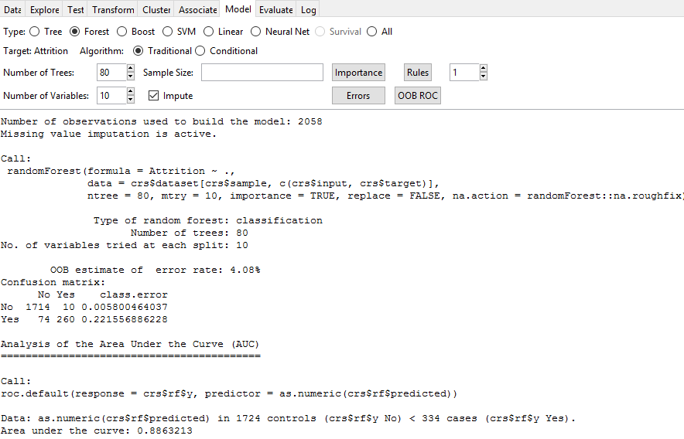
Random Forest Model using Rattle
Attrition ~ . (Training Model)
Model Performance Measures
Accuracy = 95.9% (Mis-class = 4.1%)
(Correctly classified both Attrition Yes & No values)
Precision = 77.8%
(Correctly classified Attrition Yes value)
AUC = 0.88
OOB error rate = 4.1%

Slide 14
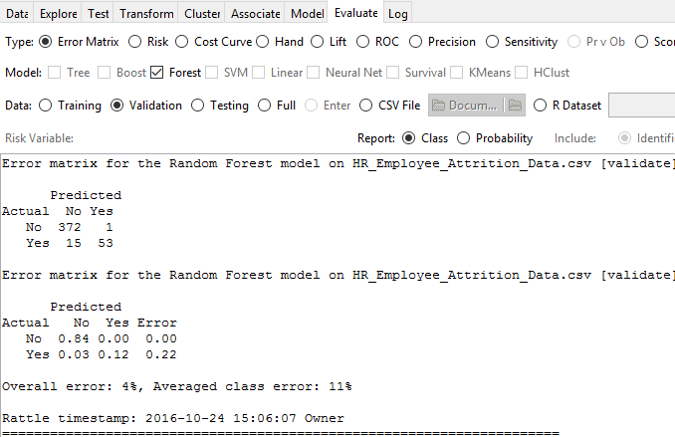
Random Forest Model using Rattle
Attrition ~ . (Validation Model)
Model Performance Measures
Accuracy = 96.4% (Mis-class = 3.6%)
(Correctly classified both Attrition Yes & No values)
Precision = 77.9%
(Correctly classified Attrition Yes value)

Slide 15
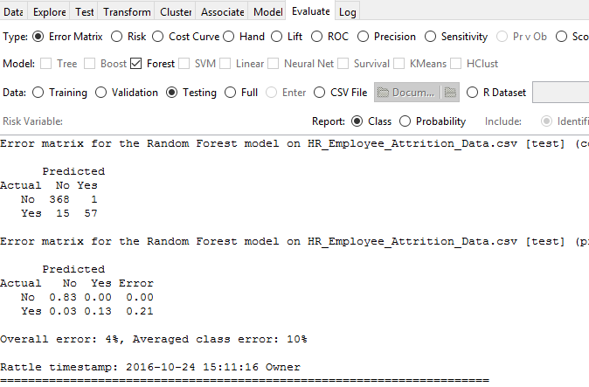
Random Forest Model using Rattle
Attrition ~ . (Test Model)
Model Performance Measures
Accuracy = 96.4% (Mis-class = 3.6%)
(Correctly classified both Attrition Yes & No values)
Precision = 79.2%
(Correctly classified Attrition Yes value)

Slide 16
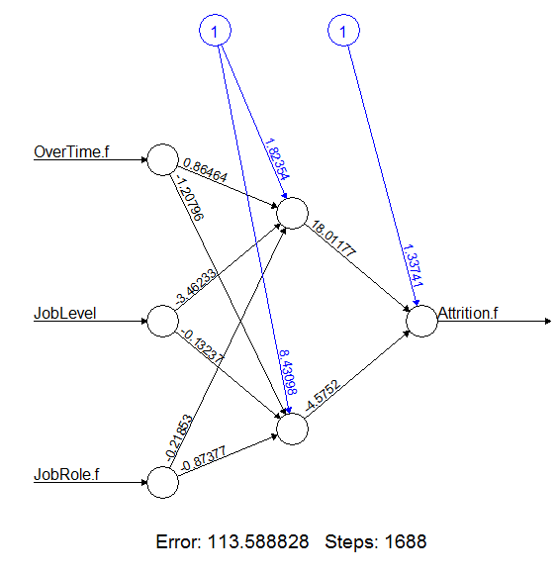
Neural Network Model using R
Attrition ~ OverTime.f+JobLevel+JobRole.f (Dev Model)
> nn1 <- neuralnet(formula = Attrition.f ~ OverTime.f+JobLevel+JobRole.f,
+ data = nn.dev,
+ hidden = 2,
+ err.fct = "sse",
+ linear.output = FALSE,
+ lifesign = "full",
+ lifesign.step = 10,
+ threshold = 0.1,
+ stepmax = 2000
+ )
> plot (nn1)
> quantile(nn1$net.result[[1]], c(0,1,5,10,25,50,75,90,95,99,100)/100)
0% 1% 5% 10% 25% 50%
0.03791900694 0.03799843140 0.03982571723 0.04057369550 0.04486392458 0.10526535709
75% 90% 95% 99% 100%
0.17186117176 0.41375590140 0.57268368629 0.72795883145 0.72795883145
> confusionMatrix(misClassTable$Attrition, misClassTable$Classification)
Confusion Matrix and Statistics
Reference
Prediction 0 1
0 1673 42
1 256 69
Accuracy : 0.8539216
95% CI : (0.8378425, 0.868976)
Running the model on significant variables after converting categorical variables Over Time and Job Role to numeric
Model Performance Measures
Accuracy = 85.4%
(Mis-class = 14.6%)
Plot shows the number of steps taken to predict scores and calculate error

Slide 17
Neural Network Model using R
Attrition ~ OverTime.f+JobLevel+JobRole.f (Holdout Model)
> x <- subset(nn.holdout,
+ select = c("OverTime.f","JobLevel", "JobRole.f")
+ )
> compute.output = compute(nn1, x)
> nn.holdout$Predict.score = compute.output$net.result
> View(nn.holdout)
> quantile(nn.holdout$Predict.score, c(0,1,5,10,25,50,75,90,95,99,100)/100)
0% 1% 5% 10% 25% 50%
0.03791900694 0.03799843140 0.03982571723 0.04057369550 0.04545354615 0.11436300242
75% 90% 95% 99% 100%
0.17186117176 0.41375590140 0.57268368629 0.72795883145 0.72795883145
> misClassTable2 = data.frame(Attrition = nn.holdout$Attrition.f, Prediction = nn.holdout$Predict.score )
> misClassTable2$Classification = ifelse(misClassTable2$Prediction>0.50,1,0)
> confusionMatrix(misClassTable2$Attrition, misClassTable2$Classification)
Confusion Matrix and Statistics
Reference
Prediction 0 1
0 731 20
1 120 29
Accuracy : 0.8444444
95% CI : (0.8190887, 0.8675204)
No Information Rate : 0.9455556
Kappa : 0.2298194
Mcnemar's Test P-Value : <0.0000000000000002
Sensitivity : 0.8589894
Specificity : 0.5918367
Pos Pred Value : 0.9733688
Neg Pred Value : 0.1946309
Scoring holdout model using compute function
Model Performance Measures
Accuracy = 84.4%
(Mis-class = 15.6%)

Slide 18
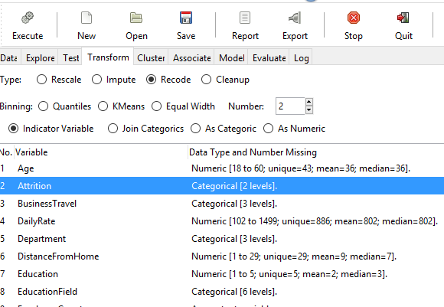
Neural Network Model using Rattle
Transform categorical data to numeric data

Slide 19
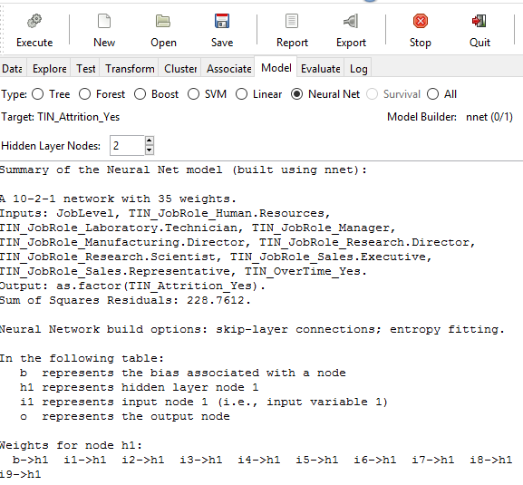
Neural Network Model using Rattle
Running Neural Network using 2 hidden layers

Slide 20
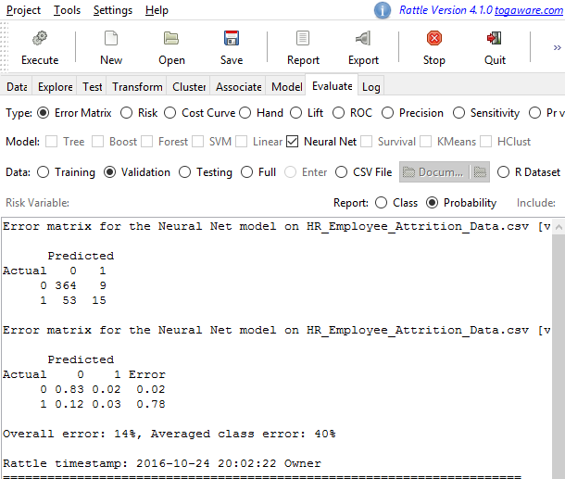
Neural Network Model using Rattle
Model Performance Measures
(Validation Data)
Accuracy = 86%
(Mis-class = 14%)

Slide 21
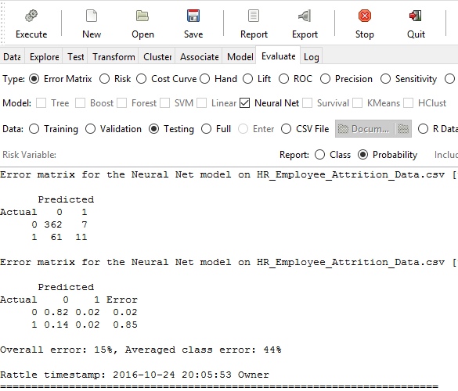
Neural Network Model using Rattle
Model Performance Measures
(Validation Data)
Accuracy = 85%
(Mis-class = 15%)

Slide 22
Final takeaway & Implementation Strategy
Final conclusion
From both Random Forest & Neural Network models and prior used Chaid/Cart classification models on HR attrition data, it can be concluded that Age, Over Time, Job Level & Job Role are factors significant which impact the attrition most.
Attrition can be predicted with
accuracy of around 95% and precision of 80% using Random Forest
accuracy of around 85% and mis-classification of 15% using Neural Network
Implementation strategy
Reach out to employees who do overtime & are in job level 1 & are in age group 18-34 to understand their work related concerns and address it appropriately so that employees in this group leave the company in lesser proportion. Few ways this can be implemented is:
Have employees attend counselling and sessions for better work/time management
Have their managers understand that work should be distributed evenly
Have gym/recreational facilities to better engage employees in younger age group

Slide 23
Thank You

